Slide 1
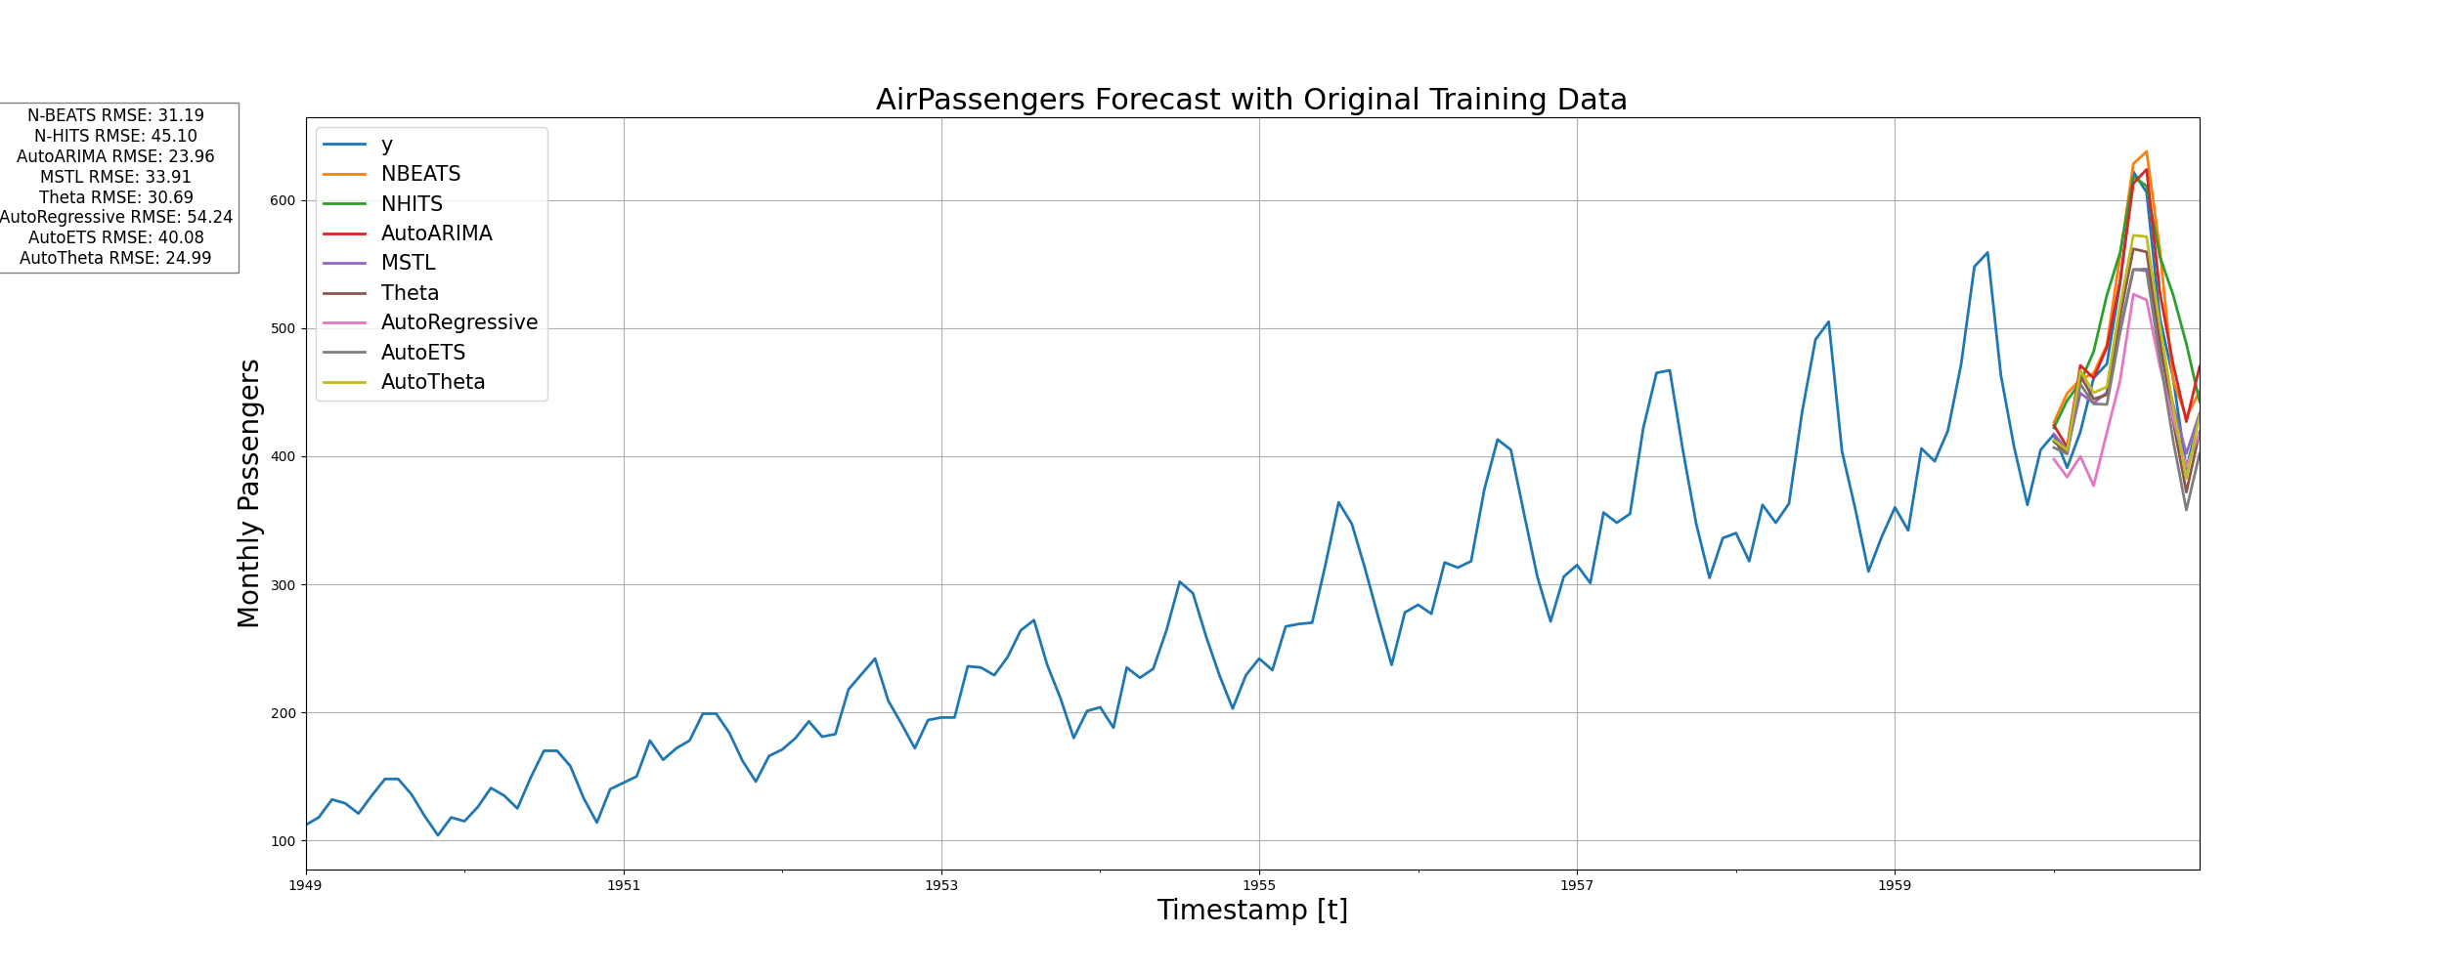

Slide 2
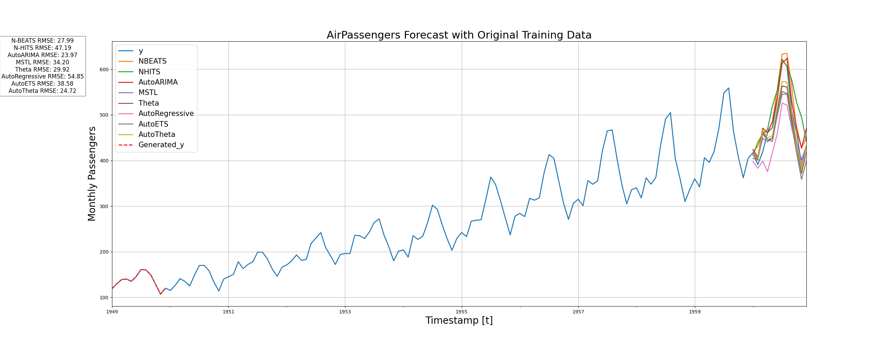
GPT 4 Generating 1 Year Data

Slide 3
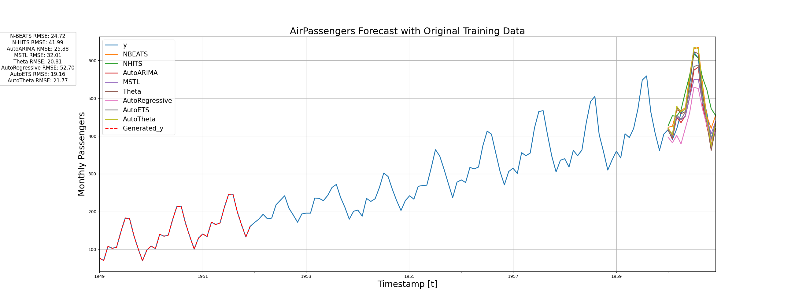
GPT 3.5

Slide 4
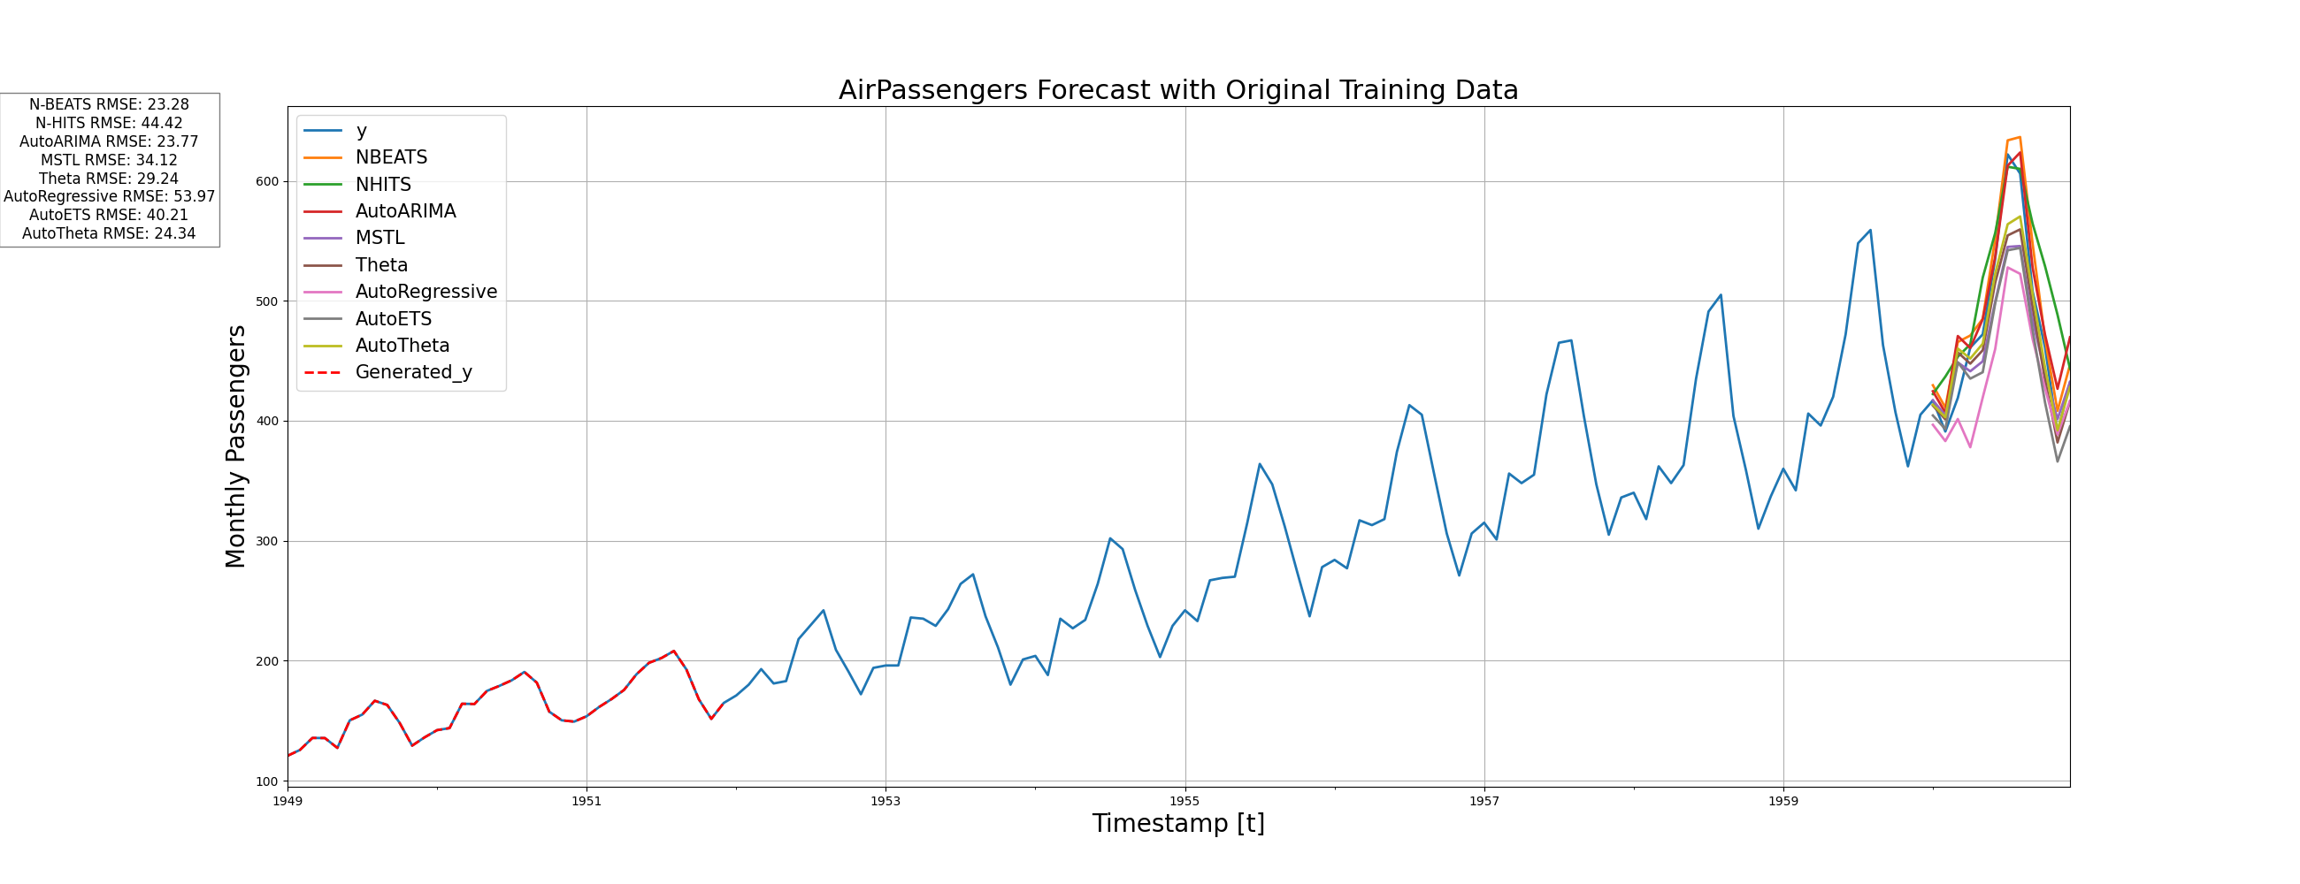
GPT 4 - 0125

Slide 5
GPT 4 - 0125

Slide 6
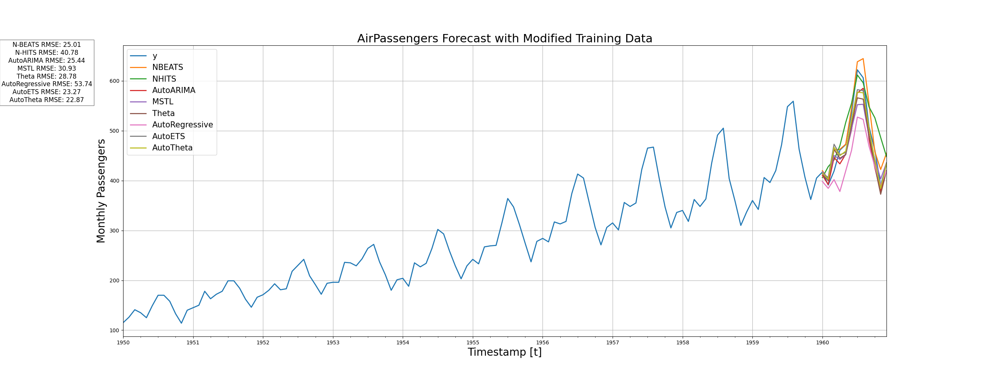

Slide 7
